Slide 1
PREDICTING NETFLIX SUBSCRIPTION TRENDS WITH PYTHON
CIS 5850 – Communication and Information Services
Instructor : Ivan Pantaleon
Presented By -
Latika Kapoor
Zalak Patel
Vamsi Sai Krishna Reddy Yarramreddy
Kajal Bhandare

Slide 2
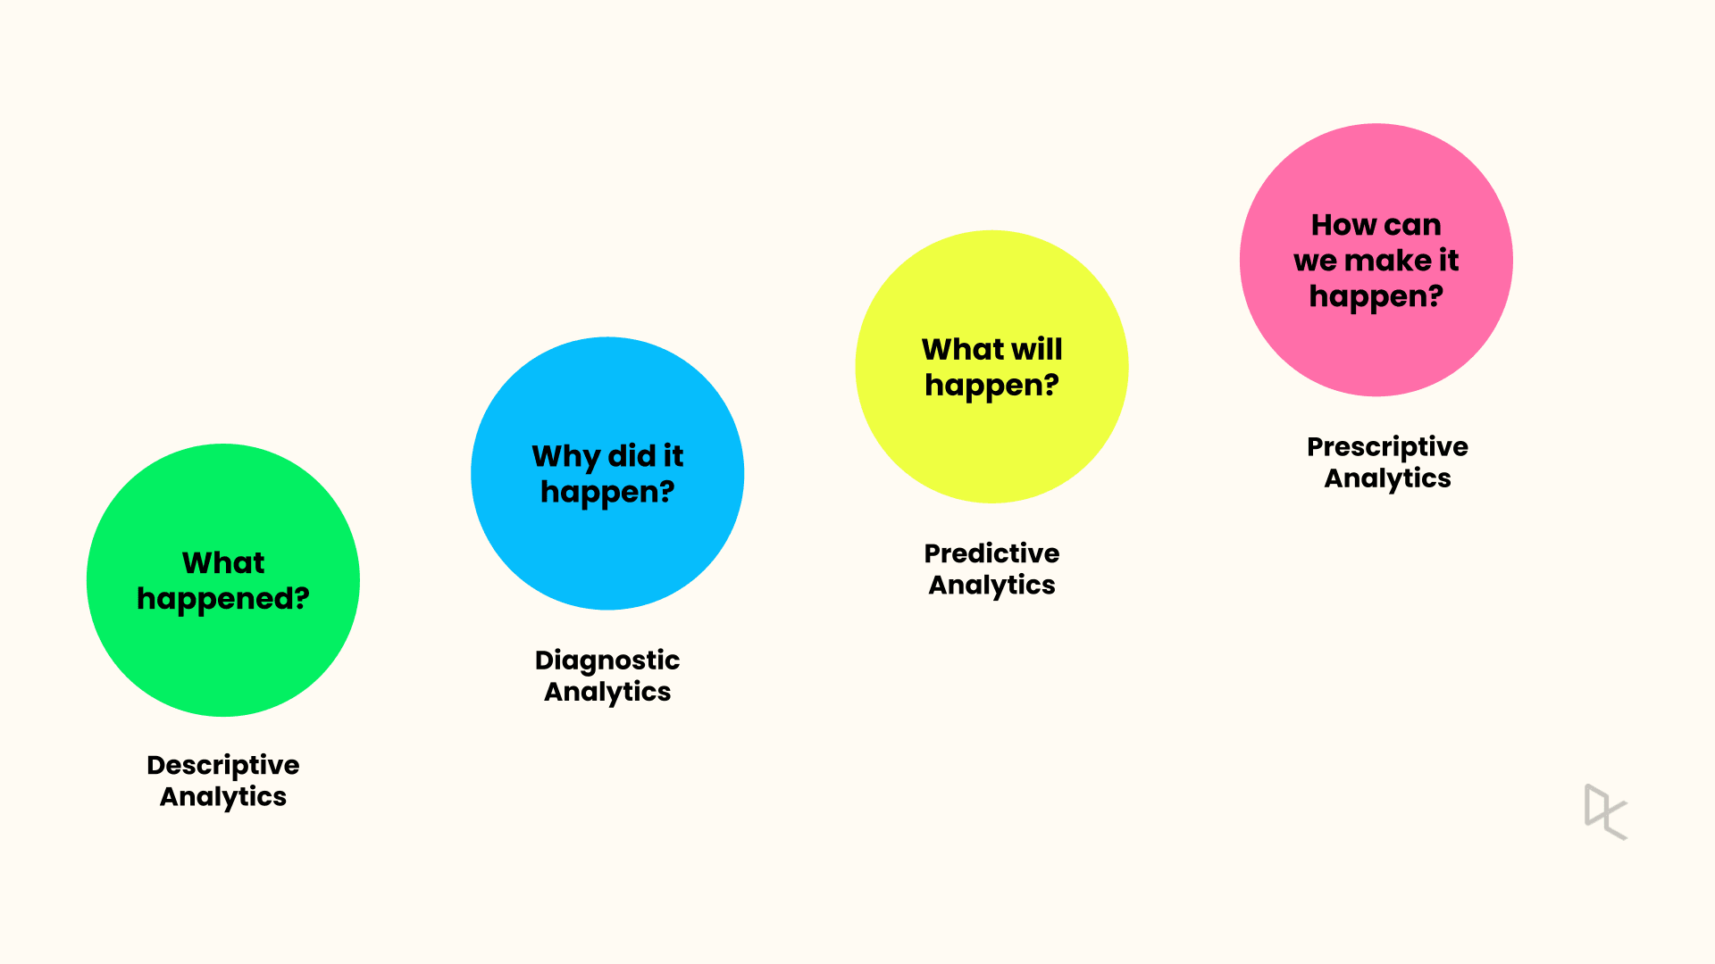
INTRODUCTION
Descriptive Analytics: "What happened?" By summarizing past data to identify trends and patterns.
Predictive Analytics: "What will happen?" Using statistical models and forecasts.

Slide 3
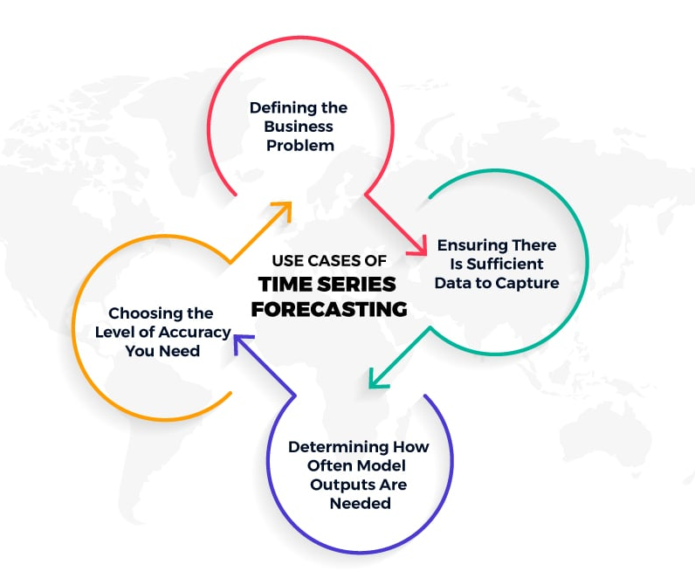
TIME SERIES FORECASTING
Identify the Problem: Determine what business issue needs forecasting
Check Data Availability: Ensure you have enough data to analyze
Select Accuracy Level: Choose how precise the forecasts need to be
Set Forecast Frequency: Decide how often you need predictions

Slide 4
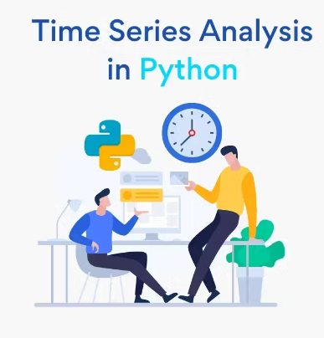
BENEFITS OF PYTHON IN TIME SERIES ANALYSIS
Python Flexibility: Utilize Python's libraries and frameworks for efficient time series analysis
ARIMA Model: Employ ARIMA for accurate predictions of subscriber trends based on historical data
Growth Insights: Analyze potential subscriber growth to inform strategic decision-making
Data Driven: Leverage Python’s capabilities to handle large datasets, ensuring detailed and reliable forecasts

Slide 5
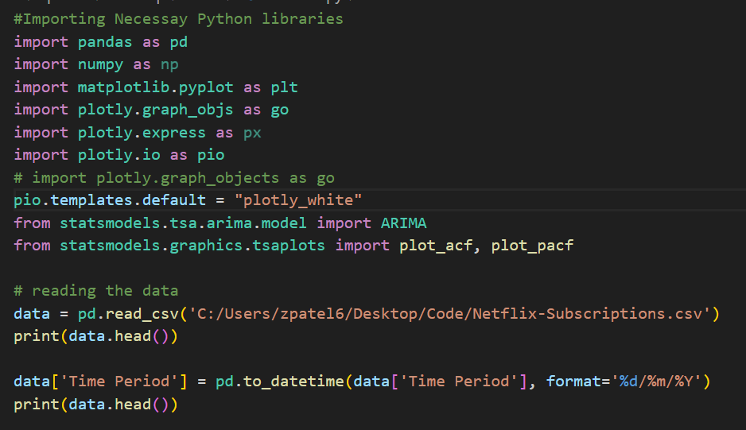
TECHNICAL INFORMATION
IDE
Visual Studio
Anaconda Navigator
Python Libraries Used for data analysis
Pandas
Numpy
Python Libraries Used for Visualization
Matplotlib
Plotly
Model Used for Forecasting
ARIMA

Slide 6
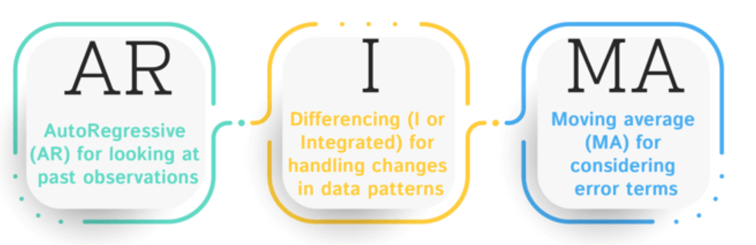
AUTO REGRESSIVE INTEGRATED MOVING AVERAGE (ARIMA)
p: Number of lagged
observations used
in the autoregressive
(AR) component.
d: Number of differencing
steps required to
achieve stationarity.
q: Number of lagged
forecast errors used
in the moving
average component.

Slide 7
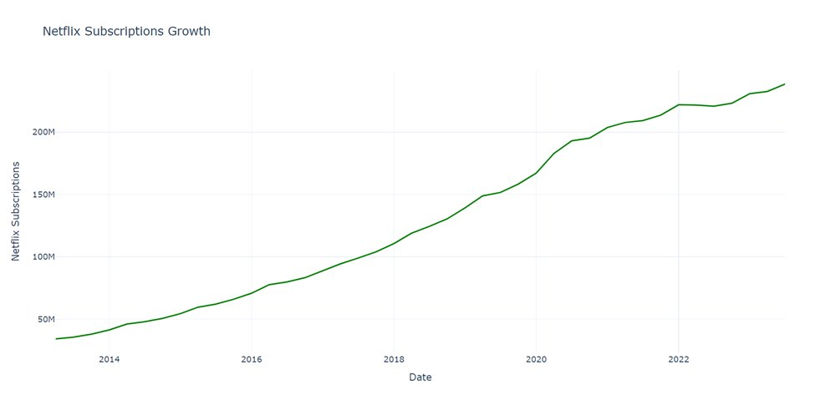
NETFLIX SUBSCRIPTION GROWTH RATE
You can see periods of highly rapid growth, such as 2016 to 2020. This might be attributed to Netflix's expansion into new markets, exclusive content releases, or clever marketing tactics.
Netflix achieved a major milestone, doubling its subscriber base in just three years, following a period of rapid growth.
Building on this momentum, Netflix then took just three years and three months to add another 63 million subscribers, surpassing 200 million in total.

Slide 8
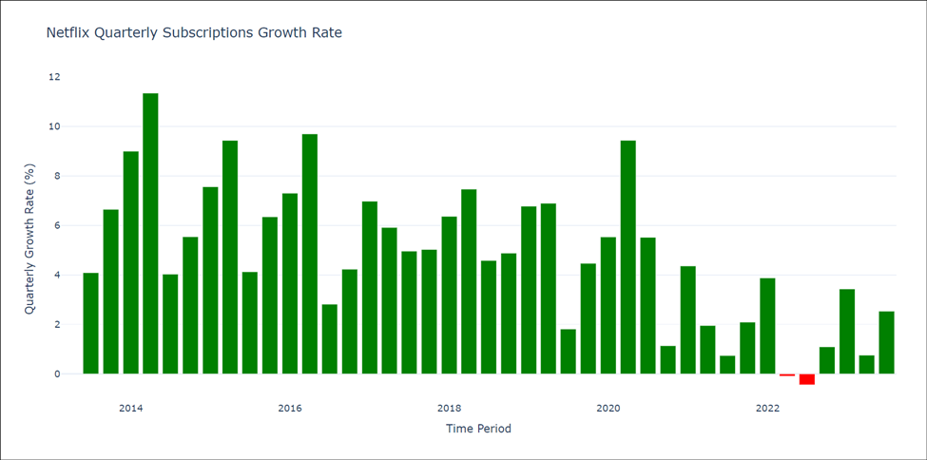
NETFLIX QUARTERLY SUBSCRIPTION GROWTH RATE
The graph shows a steady increase in Netflix users, indicating a positive growth trajectory over time.
The graph clearly demonstrates that Netflix's subscriptions increased considerably between 2014 and 2020.
Netflix saw subscriber attrition in the second and third quarters of 2022, which might be attributed to the loss of popular content from the platform owing to license expiration. Other reasons include greater competition and price increases.

Slide 9
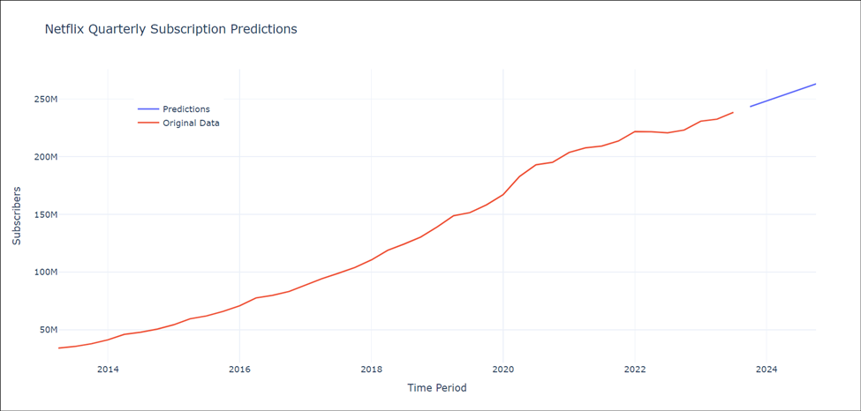
NETFLIX SUBSCRIPTION GROWTH RATE FORECASTS
The ARIMA (Autoregressive Integrated Moving Average) modeling technique was used to estimate Netflix subscription growth, taking advantage of its capacity to capture both trend and seasonality in time-series data, providing valuable insights for future planning and decision-making.
Focusing on High-Quality Originals, Genre Diversity, and Strategic Content Release are the major driving drivers to keep subscriber growth on track.
By the conclusion of the fourth quarter of 2024, subscriptions are expected to hit 263 million.

Slide 10
PROJECT INSPIRATION
Exploratory data analysis and forecasting performed by Roshan on "YouTube data: Who got the most subscribers?"
Analysis on most viewers and subscribers
Predict number of subscribers based on videos uploaded

Slide 11
BUSINESS USE CASE
Better Content Choices : Assist OTT platforms pick the right shows to make or buy, making viewers happier
Making It Easier for Viewers : Assist OTT platforms how many people use their app or website and make it easier for viewers to find and watch their favorite shows by improving how the app looks
Keeping Viewers Interested : Assist OTT platforms to offer deals, suggest shows, or provide better customer support to keep viewers from leaving
Making More Money : Assist OTT platforms to understand how to earn more money by looking at how many people subscribe and what prices to set.

Slide 12
CHALLENGES
Unable proceed with potential project "Seamless Data Sharing Using Amazon Redshift" as it required paid subscription
Due to certain copyright issues, we could nor proceed with AWS Educate course–led project “Sports Data Analytics using Amazon Athena”
Understanding ARIMA and achieve better parameter tuning

Slide 13
CONCLUSION
We conclude that subscriptions are expected to hit 263 million in the fourth quarter of 2024.
Include Additional Features
Improve Parameters Tuning

Slide 14

IMPORTANT LINKS
GitHub Link for Code, Dataset & Presentation Click Here
Project Inspiration from Kaggle Click Here
YouTube Link for Recording Click Here

